Slide 1
Exploring LLM Applications to SRA Metadata Normalization
NCBI Building Transparent ML/AI Solutions to Advance Biological Research Codeathon
Team Connor-Gunti

Slide 2

The Team
Co-Lead: Ryan Connor
Co-Lead: Jonathan Gunti
Tech-Lead: Andrey Kochergin
Writer: Corinne Matti
Dev: Priyanka Ghosh
Dev: Moyo Williams
Dev: Vadim Zalunin

Slide 3
SRA Metadata: What is it? What’s isn’t it?
Which is it?
What is it?
Non-sequence data associated with the primary sequence data
May come from the associated experiment record, a link BioSample record, or a linked BioProject record
Metadata is mostly submitter provided
Only very few fields are required
Only very few fields use a controlled vocabulary or a fixed format
Submitters may provide custom metadata fields/attributes
Issues Researchers working with SRA data face
Available fields are unknown (alternatively, fields that may contain information of interest are not known)
Values within fields are not standardized
Complicates search and downstream use
Host:
Human
H. sapiens
H. Sapiens
Homo sapiens
Homo sapens
Male
Female
Sick boy
Young girl
Healthy adult
Field names:
Viral infection
Viral infeciton
Viral infected
Viral infection condition
Viral infection conditions
Viral infection of host cell line
viral infection status

Slide 4
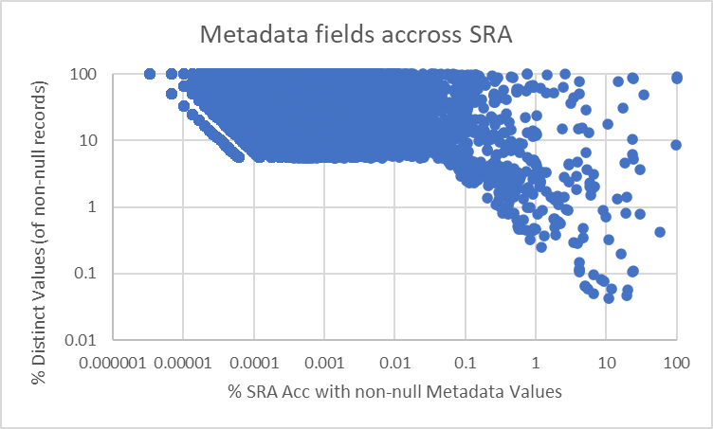
SRA Metadata: What is it?
What is it?
Non-sequence data associated with the primary sequence data
May come from the associated experiment record, a link BioSample record, or a linked BioProject record
Metadata is mostly submitter provided
Only very few fields are required
Only very few fields use a controlled vocabulary or a fixed format
Submitters may provide custom metadata fields/attributes
Issues Researchers working with SRA data face
Available fields are unknown (alternatively, fields that may contain information of interest are not known)
Values within fields are not standardized
Complicates search and downstream use

Slide 5
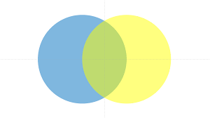
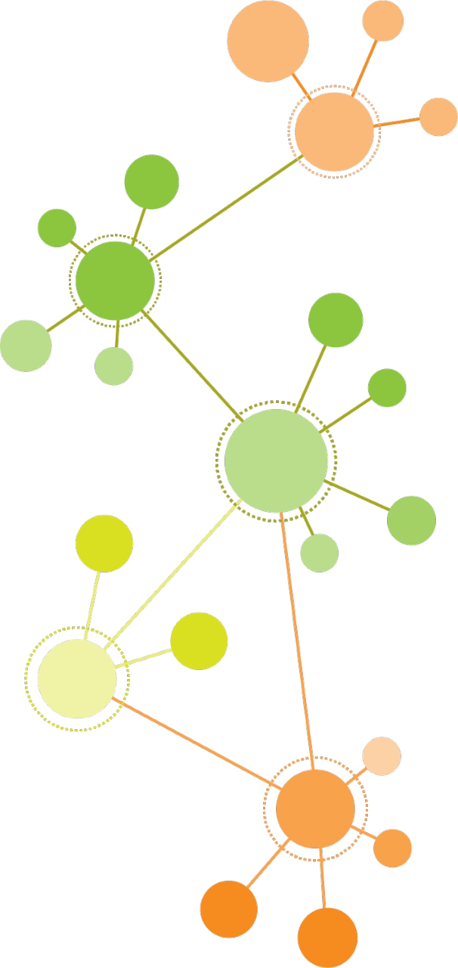


What to do about SRA metadata issues?
Problem Statement: Can LLMs be leveraged to normalize metadata values by identifying semantically similar content?
The Approach: Evaluate fit and performance of common models on metadata entry clustering. Fit will be evaluated by looking at model vocabulary overlap with tokenized metadata entries. Performance will be evaluated by looking at clustering output.
Values
Field
SRA
Metadata
?
Model Vocabulary
Models: Bert,
BioBert, etc.
Metadata:
Bio material, host, etc.

Slide 6
Technical Challenges
Sagemaker
Getting it set-up
Internet connection/Connecting to GitHub
Inputs
No pre-labeled dataset
Figuring out the best way to perform tokenization on the input data
Model selection
Finding a pretrained model that had overlapping vocabulary with our metadata input
Picking a model that works with python library we chose
Model Comparisons
Which methods are appropriate/best
No ground truth

Slide 7
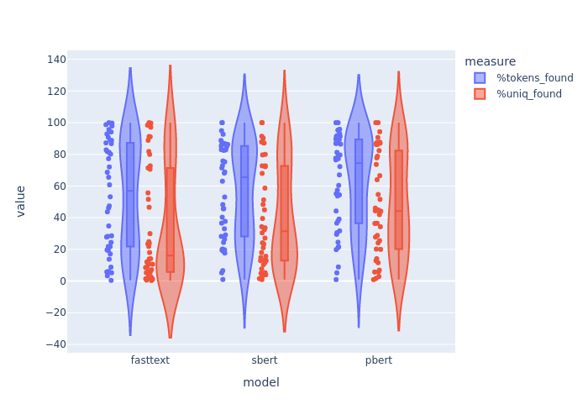
Vocabulary Overlap is Comparable Between Models

Slide 8
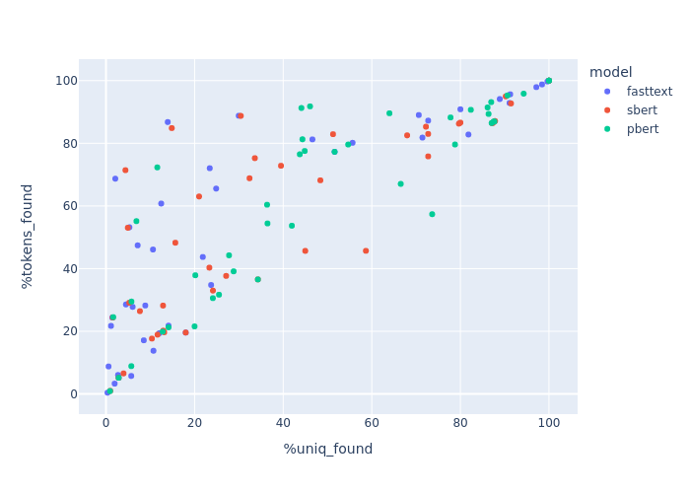
Vocab Overlap Varies Significantly by Metadata Field

Slide 9
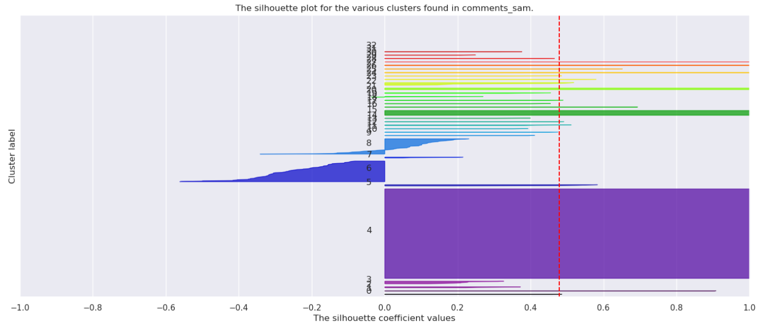
Cluster Quality is Technically Good in Most Cases …

Slide 10
But Qualitatively, Clusters Might not be Great?
Cluster 1:
'na', 'nd not determined neg negative pos positive', 'had post partum haemorrage', 'deadcaught bycatch', 'ibdv+aiv gassy yellow digesta', 'current fungal infection family history of hyper tension', 'pre-treated radiation temozolomide', 'pre-treated radiation', 'given alu and pcm’ … Cluster 2: 'adelina not present todo stool analysis', 'adelina not here to do stool analysiss’ Cluster 3:
'has a dry cough', 'has vomitting and nausea', 'paracetamol for headaches has headaches and dizziness', 'has heart palpatations vomiting 3x per day headache’
Cluster 5:
'dna52', 'dna143', 'missing_lower_legs.already_broken_up.otherwise_all_ok', 's014', 'dna172', 'dna73', 's074', 's054', 'dna138', 'dna99', 'dna2’ …

Slide 11
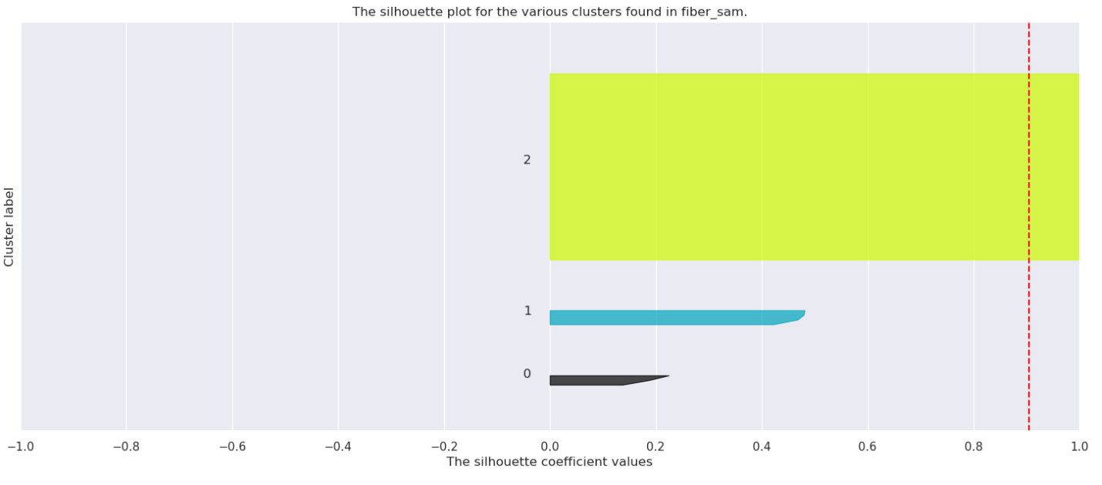
But Qualitatively, Clusters Might not be Great?
Cluster 1:
'numeric', 'number', 'not collected' Cluster 2: 'cellulose', 'pectin', 'fiber free', 'pea fiber' Cluster 3:
'16,90', '19,30', '15,20', 'cellulose/pectin', '42,40', '36,40', '52,10', '23,90', '16,80', '37,30', '29,40', '24,70', '11,50', '31,50', '31,60', '20,60', '15,60', '20,20', '14,60', '20,30', '36,10', '26,90', '13,80', '13,20', '41,10', '22,00', '34,10', '27,60', '5,90', '19,50', '55,10', '14,80', '57,60', '73,80', '58,90', '47,40', '48,00', '27,20', '58,10', '23,20', '12,20'

Slide 12
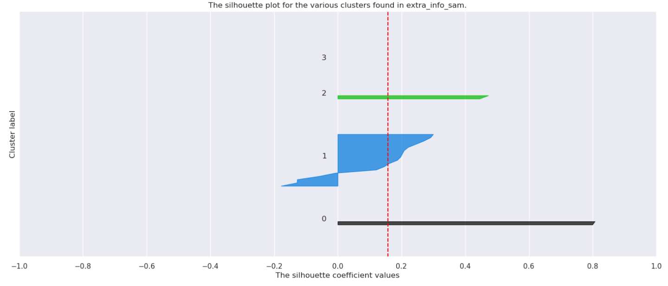
But Qualitatively, Clusters Might not be Great?
Cluster 1:
'carapace numeric mm', 'carapace number mm' Cluster 2: 'showered this morning w/o soap', 'number', 'hot yoga shirt does not smell', 'seawater sample number', 'te buffer in 16s plate only', 'hot yoga this shirt smells less', 'previous shirt smells less', 'does not notice a difference in shirts', 'swimming ocean tuesday pool wednesday', 'sedentary girlfriend sick', 'filter control number', 'jacuzzi night before holiday', 'sun burnt aloe vera applied', 'shirt feels slick', 'g3 microbiome swab fell on table contamination', 'no big difference in smell', 'acne on back' Cluster 3:
'extraction blank number', 'blank with swab’
Cluster 4: 'cross fit', 'uses marijuana', 'blank', 'surfer', 'hot yoga'

Slide 13
Follow-up / Future Directions
Deeper analysis of results from this codeathon
Research if semantic similarity is feasible without a labeled dataset
Test different clustering approaches
Curate a Ground Truth dataset
Explore something like ChatGPT to generate a larger Ground Truth –ish dataset
Evaluate if results will improve with different models/vocabularies depending on metadata field
Collect compute performance metrics to evaluate accuracy/cost
Develop/Identify Better Metrics
Split/Join for comparison of clustering across models
Evaluate a larger set of Metadata Fields
For much larger set, would require re-implementation

Slide 14
Thank You
Questions? Comments? Suggestions?

